Slide 1
Literary History
5V
November 2023, December 2023, January 2024
Test in Testweek 2

Slide 2
Literary Periods
Old English Period
500-1066
Middle English Period
1066-1500
Renaissance
1500-1660
The Regency
1811-1820
Romantic Period
1798-1870
Age of Reason
Enlightenment
1660-1800
Victorian Period
1830-1900

Slide 3
Old English Period 500-1066

Slide 4
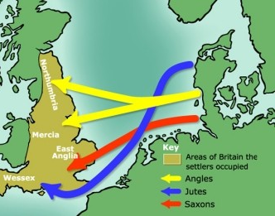
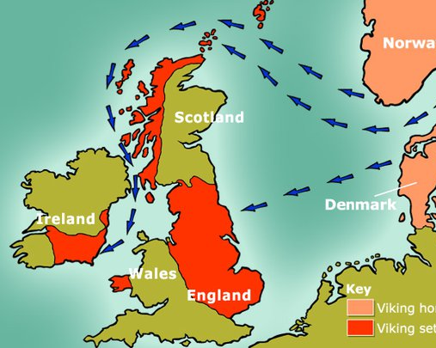
Old English Period 500-1066
History
410: The Romans withdraw from Britain. The Celts are not able to protect their borders. Invasion of Britain by Germanic tribes (Angles, Saxons, Jutes).
793: after period of relative peace, start of the Viking invasions
Literary Characteristics
Germanic influence: poems about kings and heroes.
Oral tradition
Use of alliteration
Literary works
Beowulf, author unknown. Longest known epic poem written in Old English (language spoken in Anglo Saxon Britain before 1066). The story was probably written down in the 11th century, though it takes place in 6th century Scandinavia.

Slide 5
Old English Period 500-1066
Beowulf
deals with events of the early 6th century and was probably composed c. 700–750. It tells the story of the Scandinavian hero Beowulf, who gains fame as a young man by vanquishing the monster Grendel and Grendel's mother; later, as an aging king, he kills a dragon but dies soon after, honoured and lamented.

Slide 6
Hwæt. We Gardena in geardagum, þeodcyninga, þrym gefrunon, hu ða æþelingas ellen fremedon. Oft Scyld Scefing sceaþena þreatum, monegum mægþum, meodosetla ofteah, egsode eorlas. Syððan ærest wearð feasceaft funden, he þæs frofre gebad, weox under wolcnum, weorðmyndum þah, oðþæt him æghwylc þara ymbsittendra ofer hronrade hyran scolde, gomban gyldan. þæt wæs god cyning. ðæm eafera wæs æfter cenned, geong in geardum, þone god sende folce to frofre; fyrenðearfe ongeat þe hie ær drugon aldorlease lange hwile. Him þæs liffrea, wuldres wealdend, woroldare forgeaf; Beowulf wæs breme blæd wide sprang, Scyldes eafera Scedelandum in.

Slide 7
Old English Period 500-1066
Beowulf
Answer the questions on Beowulf in your reader

